Slide 1


UNIX
About file system
UNIX file system
UNIX file types
File Naming conventions
Structure of the UNIX file system
Understanding Paths
Identifying current directory
Changing directory
Listing the contents of a directory
Changing and removing directories
File related commands
Creating links
Agenda
Knowledge grows by sharing

Slide 2


UNIX
A file system is a logical method for organizing and storing large amounts of information
Provides an organized and easier way to manage information
The file is the smallest unit in which information is stored.
Similar files are further organized under directories.
What is a
File System
and why ?
Directories are similar to the drawers of a filing cabinet
Knowledge grows by sharing

Slide 3
UNIX
UNIX treats everything as files
A directory is treated as a file that contains entries for several other files
All devices, such as I/O devices, storage devices etc are all treated as files
There are 3 types of UNIX files, namely-
    Ordinary files
    Directory files
    Special device files
UNIX
file system
Knowledge grows by sharing

Slide 4
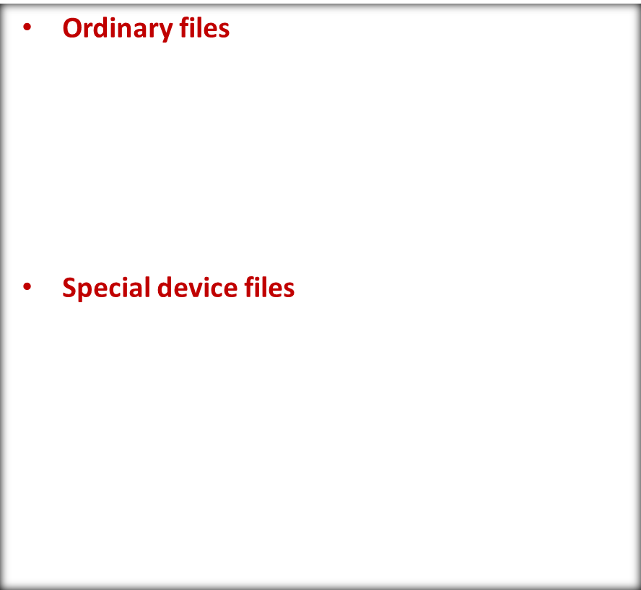




UNIX
  Simple files which store data or Information
File Types
in
UNIX
  Represents physical devices-terminal,printer,
  Floppy, and tape drives
Knowledge grows by sharing

Slide 5




UNIX
Directory files
  Files that contain other files or directories
File Types
in
UNIX
Knowledge grows by sharing

Slide 6
UNIX
A filename can consist up to 255 characters in length.
The filename may or may not have an extension .
Following characters to be used in file names are-
  Alphabets and numerals
  The period(.) , hyphen (-) and underscore (_).
UNIX imposes no restrictions on the extension ,if any, that a file should have.
A filename can also begin with a dot or end with a dot.
File Naming Conventions
Knowledge grows by sharing

Slide 7

UNIX filenames are case sensitive
A file can have as many dots embedded in its name ; Ex-a.b.c.d.e is a perfectly valid file name
UNIX filenames are case sensitive
Never use a “-“ at the beginning of a filename.
File Naming Conventions
Knowledge grows by sharing

Slide 8
UNIX
It is organized as a hierarchy of directories starting from a single directory called “root” which is represented by a / (slash).
Under the root directory are several system directories ,each having a specific purpose
The root is represented by a forward slash (/)
The forward slash(/) is also used as a separator unlike the backslash(\) that is used in Windows
Structure of the UNIX
file system
UNIX – “/” , Windows-”\”
Knowledge grows by sharing

Slide 9







UNIX
root
Structure of the UNIX
file system contd.
bin
dev
etc
lib
tmp
home
mnt
The file system is an inverted tree structure with system directories below the topmost “root” directory
Knowledge grows by sharing

Slide 10



UNIX
Every directory in UNIX is referred to by using it’s pathname
Directory names are separated by a “/ “
Root directory is represented by a “/”
There are two types of pathnames.These are-
    Absolute pathname
    Relative pathname
Path and pathnames
Indicates the complete pathname of a directory starting from the root.
Indicates the location of a directory ,relative to the current working directory.
Knowledge grows by sharing

Slide 11







UNIX
root
Absolute pathname of the delhi directory is /usr/mini/sales/north/delhi
usr
mini
sales
Suppose the current directory is /usr/mini/sales/north,then the relative pathname of GK directory is delhi/GK or
./delhi/GK
north
Absolute , Relative pathnames
delhi
GK
.(Single dot)→ Current Directory
..(Double dot)→Parent directory
Pathnames should not contain any vacant space.
Knowledge grows by sharing

Slide 12
UNIX
pwd
mkdir
cd
ls
rmdir
Directory
commands
Knowledge grows by sharing

Slide 13
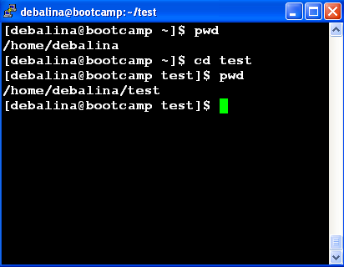
UNIX
The
"pwd"
command
“pwd” displays the absolute pathname of the current directory.
Knowledge grows by sharing

Slide 14
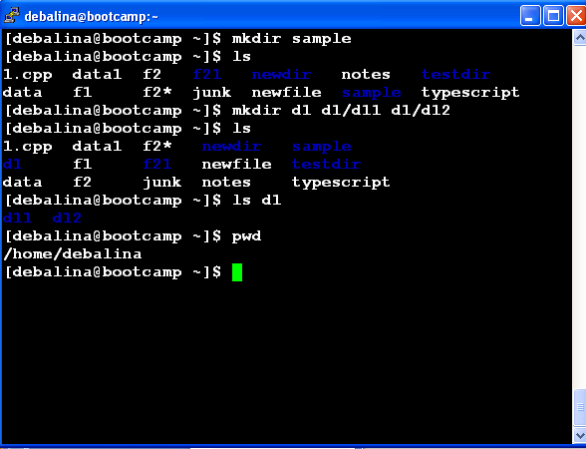
UNIX
The
"mkdir"
command
“mkdir” only creates a directory, but does not change to the created directory
Knowledge grows by sharing

Slide 15
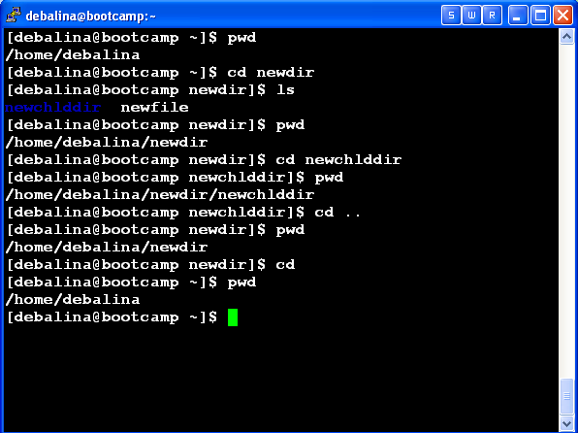
UNIX
The
"cd"
command
“cd” does not display the changed directory name as such.
Knowledge grows by sharing

Slide 16
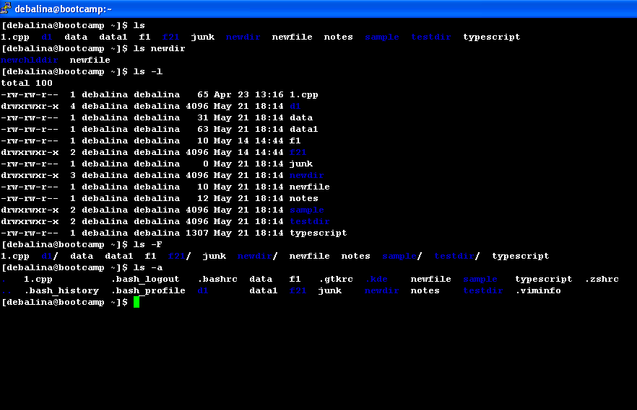
UNIX
The
"ls"
command
Knowledge grows by sharing

Slide 17
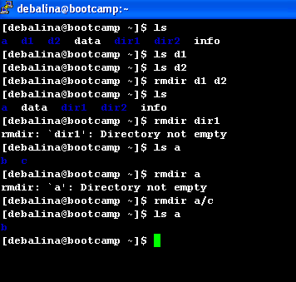
UNIX
The
"rmdir"
command
Knowledge grows by sharing

Slide 18

UNIX
cat
cp
rm
mv
File
commands
Knowledge grows by sharing

Slide 19
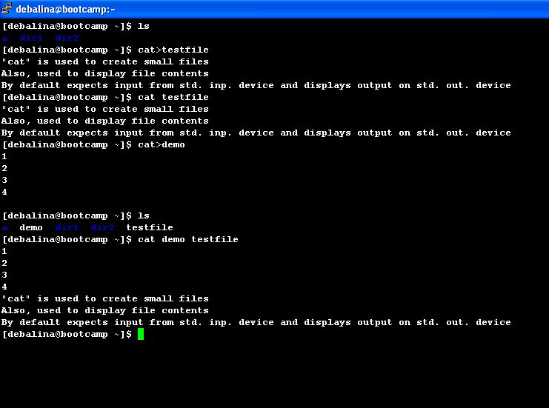
UNIX
The
"cat"
command
Knowledge grows by sharing

Slide 20
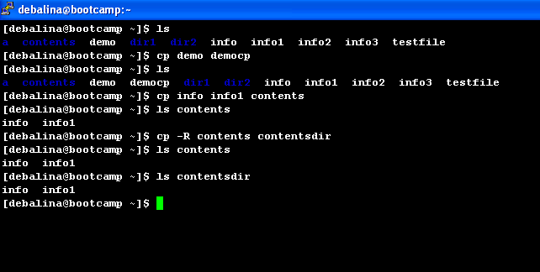
UNIX
The
"cp"
command
“cp” overwrites without warning the destination file.
Knowledge grows by sharing

Slide 21
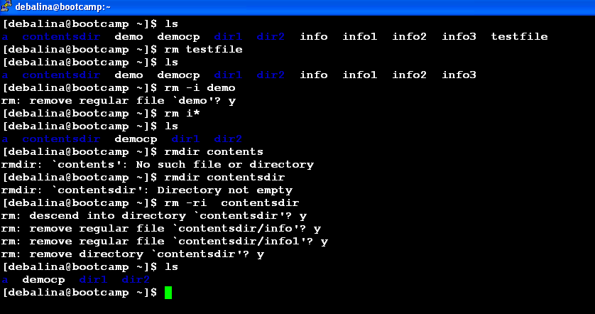
UNIX
The
"rm"
command
Knowledge grows by sharing

Slide 22
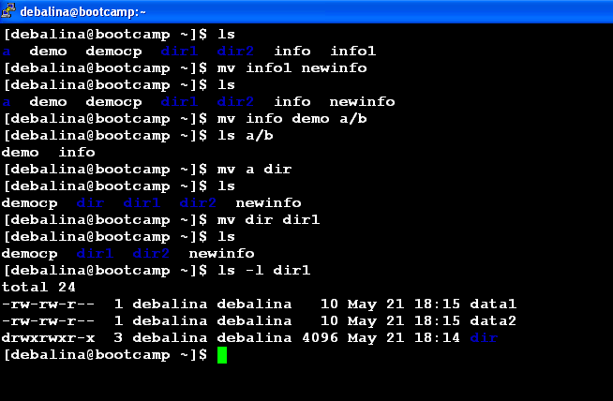
UNIX
The
"mv"
command
By default,”mv” does not prompt for overwriting the destination file if it exists.
Knowledge grows by sharing

Slide 23
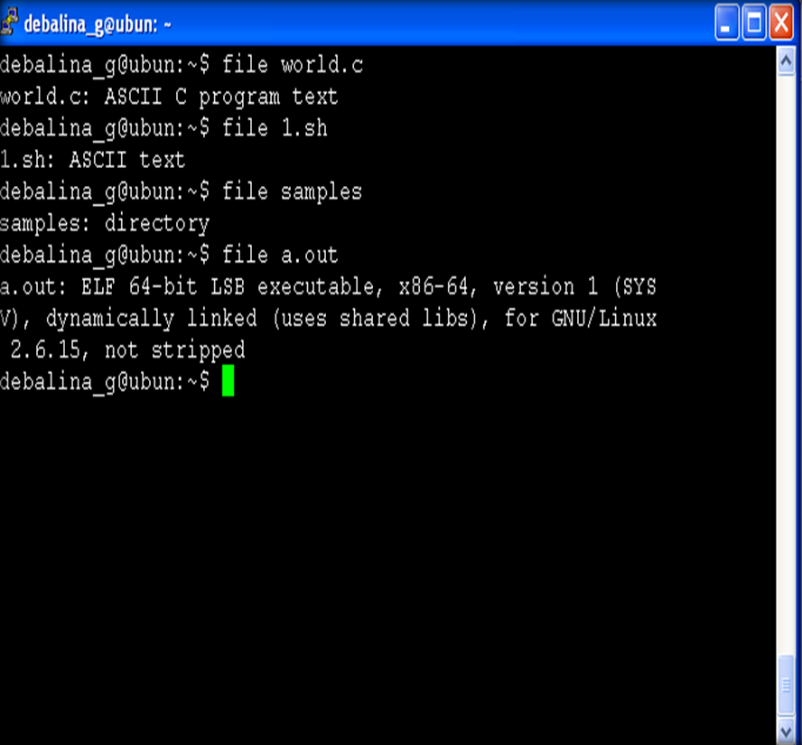
UNIX
The
"file"
command
Knowledge grows by sharing

Slide 24
UNIX
Sometimes it maybe required to set the modification and access time for a file to some predefined values.
The touch command can be used to change these times.
Command usage is-
  touch options expression filename(s)
When touch is used without any options or expressions both the times are set to the current time.
If the file is not created then touch creates it as well.
The
"touch"
command
Knowledge grows by sharing

Slide 25
Expression is given in the following format- “MMDDhhmm”.
Optionally year can be given as a two or four digit year string.
To change only modification time “-mt“ option is used and to change the access time “-at” option is used.
To change only modification date “-md“ option is used and to change the access date “-ad” option is used.
The
"touch"
command
Knowledge grows by sharing

Slide 26

UNIX
$ touch -at 201504181345.30 demo.txt -//changing access time
$ touch -mt 201504251445.30 demo.txt //changing mod time
$ touch -ad 20141225 demo.txt -//change only access date
$touch demo.txt //changes all timestamps to current time
The
"touch"
command
Knowledge grows by sharing

Slide 27
UNIX
$touch -mat 201510251445.30 demo.txt //change both access and mod to same value
$ stat demo.txt
File: `demo.txt'
Size: 122 Blocks: 8 IO Block: 4096 regular file
Device: 305h/773d Inode: 4227293 Links: 1
Access: (0664/-rw-rw-r--) Uid: ( 503/ user1) Gid: ( 505/ user1)
Access: 2015-10-25 14:45:30.000000000 +0530
Modify: 2015-10-25 14:45:30.000000000 +0530
Change: 2014-08-11 14:12:14.963222088 +0530
The
"touch"
command
Knowledge grows by sharing

Slide 28

UNIX
$ ls -li result.sh //checking the inode value
392615 -rw-r--r-- 1 debalina_g debalina_g 166 2012-02-15 11:34 result.sh
$ ln result.sh lnresult //creating a link
$ ls -li result.sh lnresult //Viewing the inode values of both
392615 -rw-r--r-- 2 debalina_g debalina_g 166 2012-02-15 11:34 lnresult
392615 -rw-r--r-- 2 debalina_g debalina_g 166 2012-02-15 11:34 result.sh
$ ln lnresult lnresult1 //creating another link from a link
Creating links
Knowledge grows by sharing

Slide 29

Knowledge grows by sharing

